Slide 1

ASP.NET MVC 4
Scott Guthrie
Corporate VP Server & Tools Business

Slide 2
Lots of New ASP.NET MVC 4 Features
Bundling/Minification Support
Database Migrations
Web APIs
Mobile Web
Real Time Communication
Asynchronous Support
Works with VS 2010/.NET 4 and built-into VS11

Slide 3
Demo:
File->New Project
Notes:
Modern Web Development

Slide 4
Bundling and Minification
Improve loading performance of JavaScript and CSS
Reduce # and size of HTTP requests
Works by convention (no configuration required)
Fully customizable and extensible

Slide 5
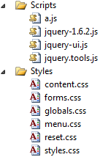
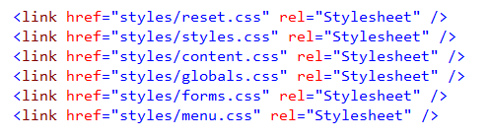
Bundling and Minification

Slide 6
Demo: Bundling & Minification

Slide 7
URL Resolution Enhancements
Razor now resolves ~/ within all standard HTML attributes
Today you write:
Razor now allows you to just write:
<script src=”@Url.Content(“~/Scripts/Site.js”)”></script>
<script src=”~/Scripts/Site.js”)”></script>

Slide 8
Conditional Attribute Enhancements
Today you write:
@{
string myClass = null;
if (someCondition) {
myClass = ”shinyFancy”;
}
}
<div @{if (myClass != null) { <text>class=”@myClass”</text> } }>Content</div>

Slide 9
Conditional Attribute Enhancements
Now you can write:
Will automatically omit attribute name if value is null
@{
string myClass = null;
if (someCondition) {
myClass = ”shinyFancy”;
}
}
<div class=”@myClass”>Content</div>

Slide 10
Database Migrations

Slide 11
Database Migrations
EF is a powerful O/RM for .NET
EF Code First provides a convention-over-configuration based development approach
Migrations == code-oriented approach to evolve DB schema
Code focused
Developer friendly
Can be used to generate SQL change scripts to pass off to a DBA

Slide 12
Demo: Database Migrations with EF 4.3
Tip: “update-package EntityFramework”

Slide 13
Why Web APIs?

Slide 14
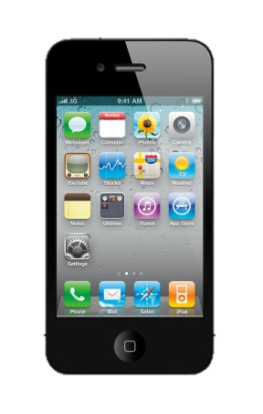




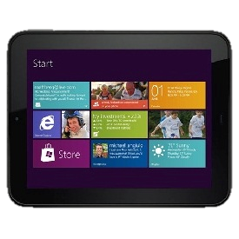
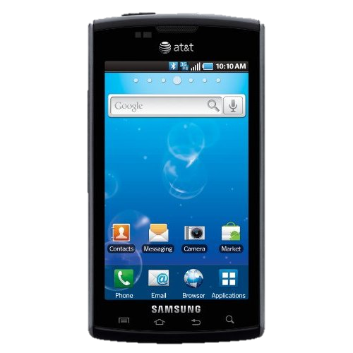
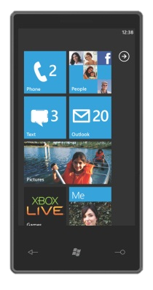

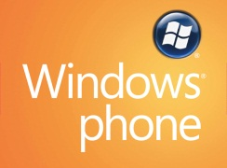

Build Richer Apps
Reach More Clients

Slide 15
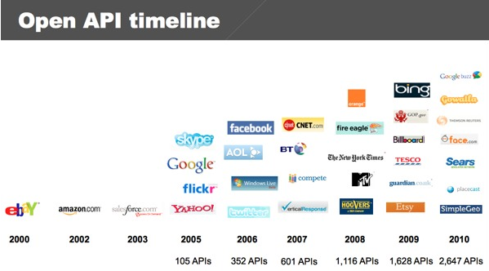
Web API Growth
+ 16%
+ 100%
+ 50%
+ 3400%
+ 235%
+ 71%
+ 86%
+ 46%
+ 63%
Source: www.programmableweb.com – current APIs: 4535

Slide 16
GET /en/html/dummy.php?name=MyName&married=not+single &male=yes HTTP/1.1
Host: www.explainth.at
User-Agent: Mozilla/5.0 (Windows;en-GB; rv:1.8.0.11) Gecko/20070312 Firefox/1.5.0.11
Accept: text/xml,text/html;q=0.9,text/plain;q=0.8,image/png,*/*;q=0.5
Accept-Language: en-gb,en;q=0.5
Accept-Encoding: gzip,deflate
Accept-Charset: ISO-8859-1,utf-8;q=0.7,*;q=0.7
Keep-Alive: 300
Connection: keep-alive
Referer: http://www.explainth.at/en/misc/httpreq.shtml
Embrace HTTP
Notes:
Use HTTP as an Application Protocol – not a Transport Protocol

Slide 17
Demo: Building
a Web API
Notes:
Add
Implement Get() for all and Get() for single
Show Content Negotiation
Show Odata Support
Show using Post()
Content-Type: application/json
{
"Name":"blah4",
"UnitPrice":45.56
}
// POST /api/products
public HttpResponseMessage<Product> Post(Product product) {
db.Products.Add(product);
db.SaveChanges();
var result = new HttpResponseMessage<Product>(product, HttpStatusCode.Created);
result.Headers.Location = new Uri(Request.RequestUri, "/api/products/" + product.ID.ToString());
return result;
}

Slide 18
Demo: Calling a Web API from JavaScript

Slide 19
Web API Testing
Removed reliance on static context objects
Dependencies can be supplied via simple constructor params for easy unit testing
At runtime, constructor parameters can be supplied via the DependencyResolver (same IOC model as rest of MVC)

Slide 20
Demo: Unit Testing
a Web API

Slide 21
Web API Hosting
Multiple ways to host and expose Web APIs:
Within ASP.NET applications inside IIS, IIS Express, VS Web Server
Self hosted within any custom app (console, Windows Service, etc)
Same programming model
Maximum flexibility

Slide 22
Demo: Hosting
Web APIs

Slide 23
Mobile Web

Slide 24
Mobile Web Development – A Spectrum
Adaptive Rendering
Display Modes
Mobile Template
Mostly
Desktop
Mostly
Mobile

Slide 25
Mobile Web with ASP.NET MVC 4
Adaptive Rendering
Use of CSS Media Queries within default project templates
Display Modes
Selectively adapt views based on devices
Mobile Optimized Templates
jQuery Mobile

Slide 26
Demo: Mobile Web

Slide 27
Real Time Communication with SignalR
Client to Server persistent connection over HTTP
Easily build multi-user, real-time web applications
Allows server-to-client push and RPC
Built async to scale to 000’s of connections
Auto-negotiates transport:
WebSockets (ASP.NET 4.5 on Windows 8)
Server Sent Events (EventSource)
Forever Frame
Ajax Long Polling
Open Source on GitHub (https://github.com/signalr/)

Slide 28
Chat with SignalR Hubs
Client – JavaScript | Server - .NET
var hub = $.connection.chat; hub.addMessage = function (msg) { $("#msgs").append("<li>" + msg + "</li>"); }; $.connection.hub.start().done(function() { $("#send").click(function() { hub.sendMessage($("#msg").text()); }); }); | public class Chat : Hub { public void SendMessage(string message) { Clients.addMessage(message); } }

Slide 29
Demo: SignalR

Slide 30
Asynchronous Support
Why use async on a server?
Enables more efficient use of threads and server resources
How does it work?
Your controller class yields to ASP.NET when calling a remote resource, allowing the server thread to be re-used while you wait
When remote call returns, controller is re-scheduled to complete
Reduces # of threads running -> increases scalability
Use of async on server is not exposed to browsers/clients
http://myserver.com/products -> same URL can be implemented in ASP.NET using either a synchronous or async controller

Slide 31
Async in MVC Today
public class Products : AsyncController {
public void IndexAsync() {
WebClient wc1 = new WebClient();
AsyncManager.OutstandingOperations.Increment();
wc1.DownloadStringCompleted += (sender, e) => {
AsyncManager.Parameters[“result"] = e.Result;
AsyncManager.OutstandingOperations.Decrement();
};
wc1.DownloadStringAsync(new Uri("http://www.bing.com/"));
}
public ActionResult IndexCompleted(string result) {
return View();
}
}

Slide 32
Async in MVC with VS 11
public class Products : Controller {
public async Task<ActionResult> IndexAsync() {
WebClient web = new WebClient();
string result = await web.DownloadStringAsync("www.bing.com/");
return View();
}
}

Slide 33
Lots of New ASP.NET MVC 4 Features
Bundling/Minification Support
Database Migrations
Mobile Web
Web APIs
Real Time Communication
Asynchronous Support
Works with VS 2010/.NET 4 and built-into VS11

Slide 34
Announcing ASP.NET MVC 4 Beta
Available for Download Now
http://bit.ly/xicqzI

Slide 35
Questions

